Slide 1
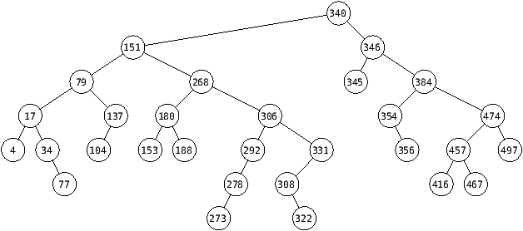
4

Slide 2
INORDEN: 4, 17, 34, 77, 79, 104, 137, 151, 153, 180, 188, 268, 273, 278, 292, 306, 308, 322, 331, 340, 345, 346, 354, 356, 384, 416, 457, 467, 474, 497
PREORDEN: 340, 151, 79, 17, 4, 34, 77, 137, 104, 268, 180, 153, 188, 306, 292, 278, 273, 331, 308, 322, 346, 345, 384, 354, 356, 474, 457, 416, 467, 497
POSTORDEN: 4, 77, 34, 17, 104, 137, 79, 153, 188, 180, 273, 278, 292, 322, 308, 331, 306, 268, 151, 345, 356, 354, 416, 467, 457, 497, 474, 384, 346, 340
EN AMPLITUD: 340, 151, 346, 79, 268, 345, 384, 17, 137, 180, 306, 354, 474, 4, 34, 104, 153, 188, 292, 331, 356, 457, 497, 77, 278, 308, 416, 467, 273, 322

